Slide 1


PROJECT PRESENTATION
Seeing Through The Rings:
Unveiling Olympic History
GARVIT APURB SHREY SHIVAM ROHIT HARJAP HIMESH DEEPESH SANIDHYA

Slide 2
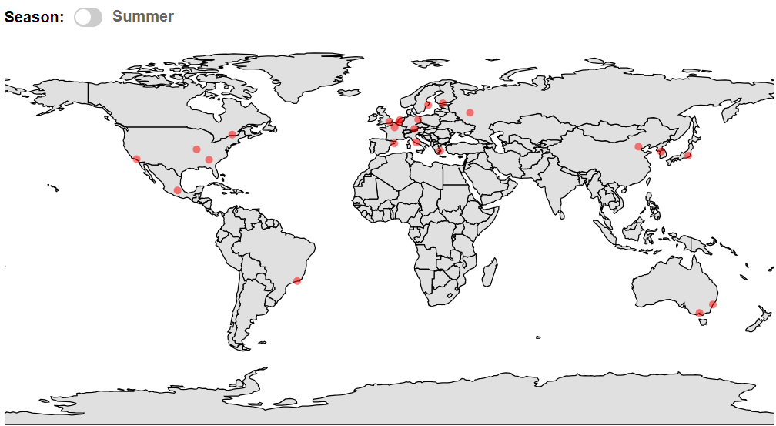
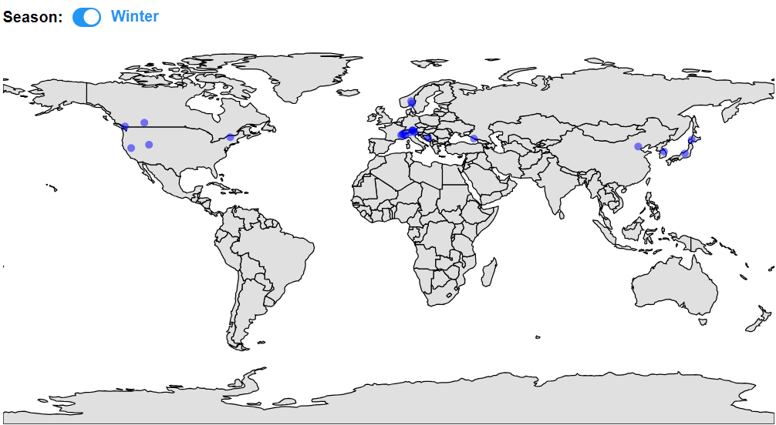
CS661
HOST MAP
A world map showing the locations of all the cities that have hosted the Olympics till date.
There is a toggle button to switch between Summer and Winter

Slide 3
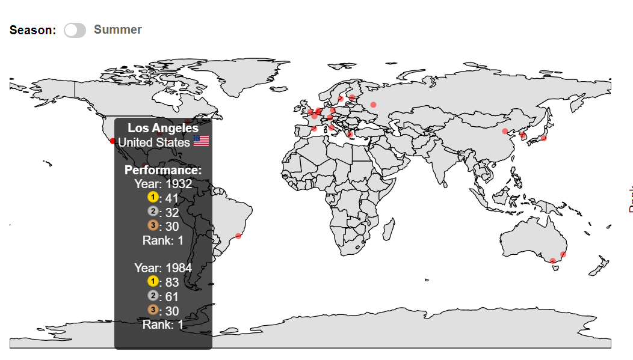
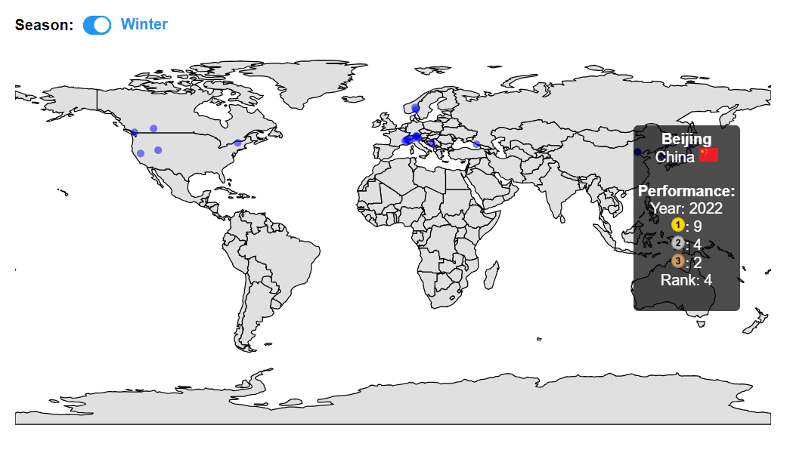
CS661
HOST MAP
Hovering over a city shows the performance of the host country in all the years it hosted.

Slide 4
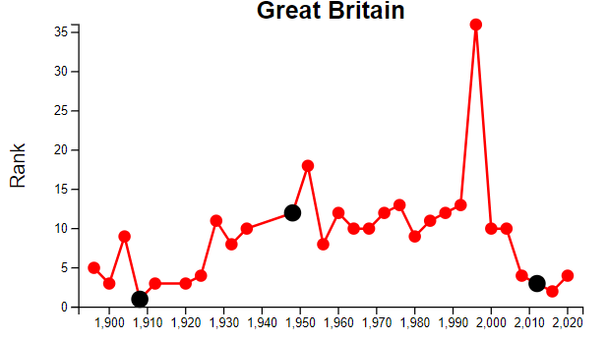
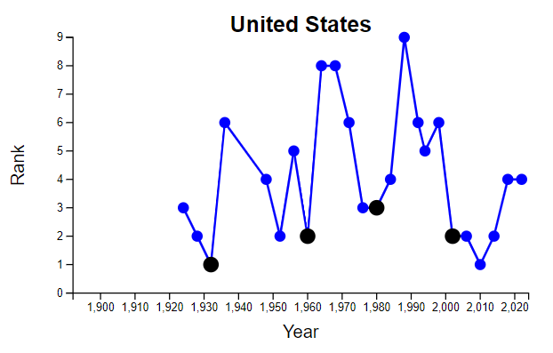
CS661
LINE CHART
Clicking on a city shows the line chart variation of the host country rank over time. The years in which it hosted are marked with black dots.

Slide 5
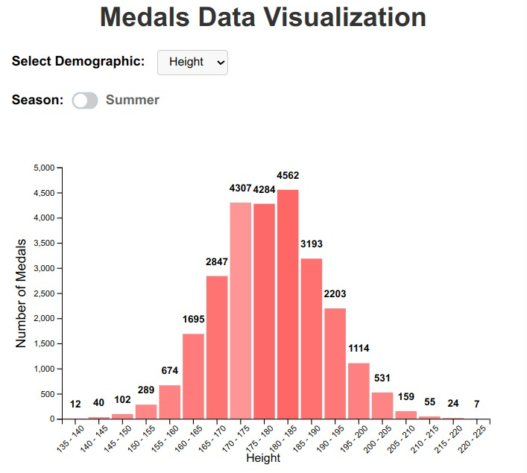
CS661
ANALYSIS OF MEDALS vs DEMOGRAPHICS
BAR CHARTS
Analysis based on Demographics of Athletes:
Height
Age
Weight
Sex
Hovering over the bars highlights it and shows the number of medals won by each category
Analysis of both Seasons: Summer and Winter

Slide 6
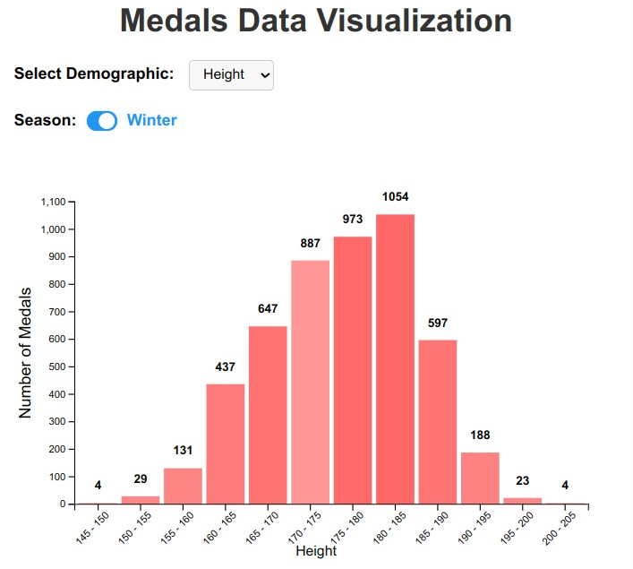
CS661
ANALYSIS OF MEDALS vs DEMOGRAPHICS
BAR CHARTS
Analysis based on Demographics of Athletes:
Height
Age
Weight
Sex
Hovering over the bars highlights it and shows the number of medals won by each category
Analysis of both Seasons: Summer and Winter

Slide 7
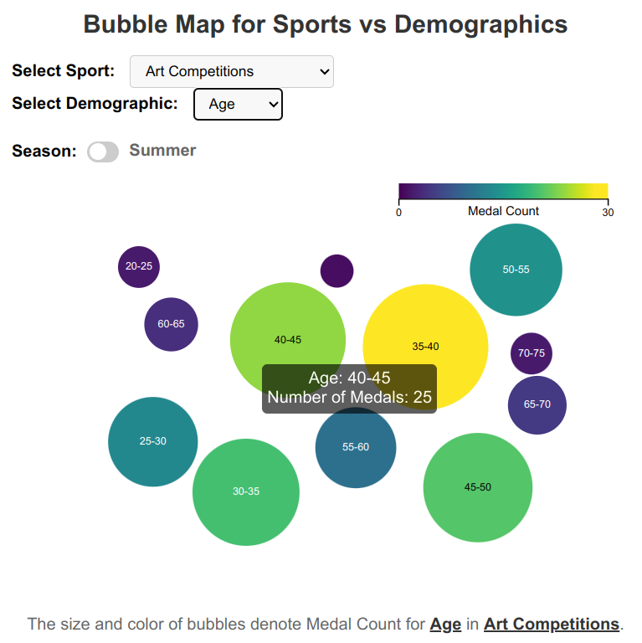
CS661
ANALYSIS OF MEDALS vs DEMOGRAPHICS
BUBBLE MAP FOR EACH SPORT
Analysis of each sport
Analysis based on Demographics of Athletes:
Height
Age
Weight
Sex
Hovering over the bubbles show the category range and number of medals won by each category
Analysis of both Seasons
Minimized the intersection of bubbles
Size and Color of bubbles to represent the number of medals

Slide 8
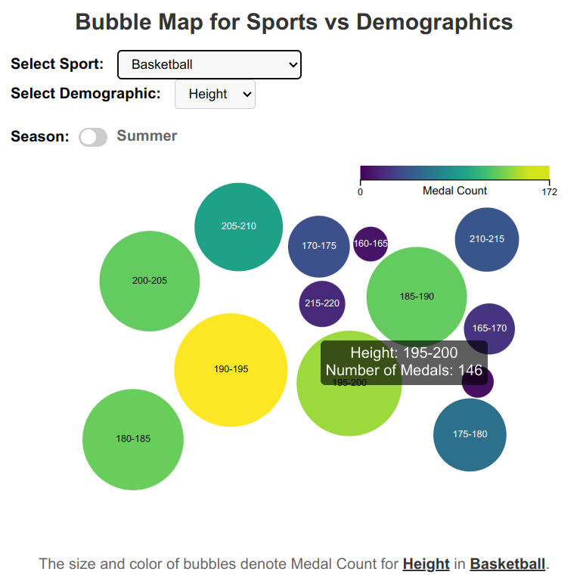
CS661
ANALYSIS OF MEDALS vs DEMOGRAPHICS
BUBBLE MAP FOR EACH SPORT
Analysis of each sport
Analysis based on Demographics of Athletes:
Height
Age
Weight
Sex
Hovering over the bubbles show the category range and number of medals won by each category
Analysis of both Seasons
Minimized the intersection of bubbles
Size and Color of bubbles to represent the number of medals

Slide 9
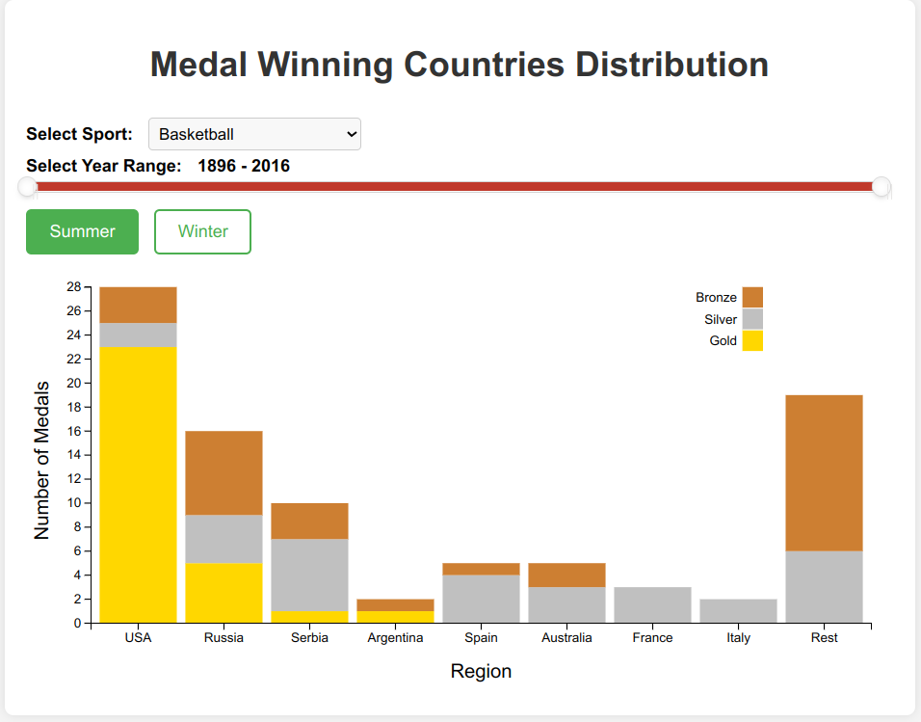
CS661
DISTRIBUTION OF MEDALS VS COUNTRIES
APPROACH
Preprocessing the athlete data to segregate by NOC regions
Designing Stacked Bar Charts to show performance of various countries
Querying, Filtering and Selection support provided

Slide 10
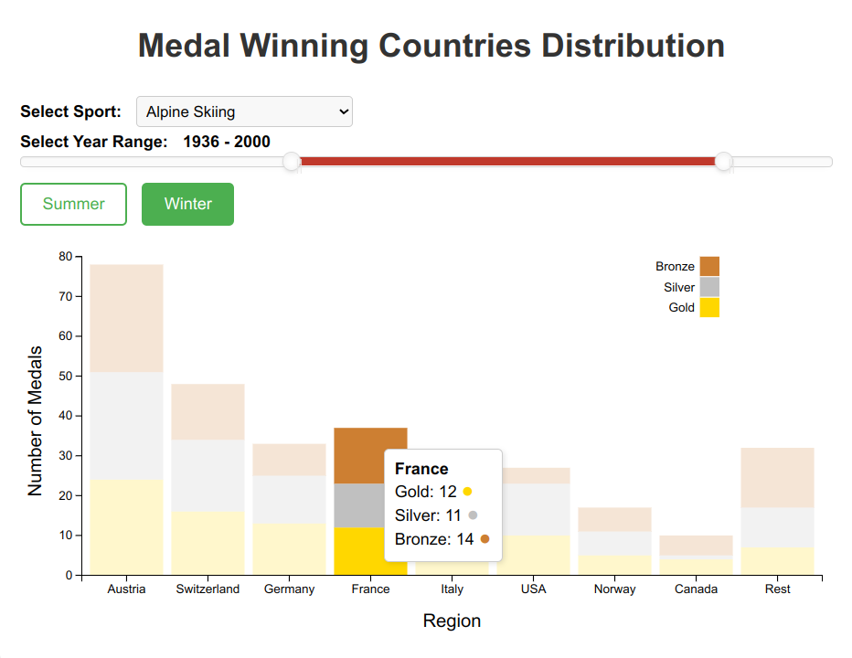
CS661
DISTRIBUTION OF MEDALS VS COUNTRIES
DESIGN PRINCIPLES
"Overview first, zoom and filter, then details-on-demand"
Insights about the Top 8 countries VS the rest of the world
Filtering by Sport and Querying for desired year range,
toggle button between Winter and Summer season
Medal breakdown for individual countries as per details-on-demand

Slide 11
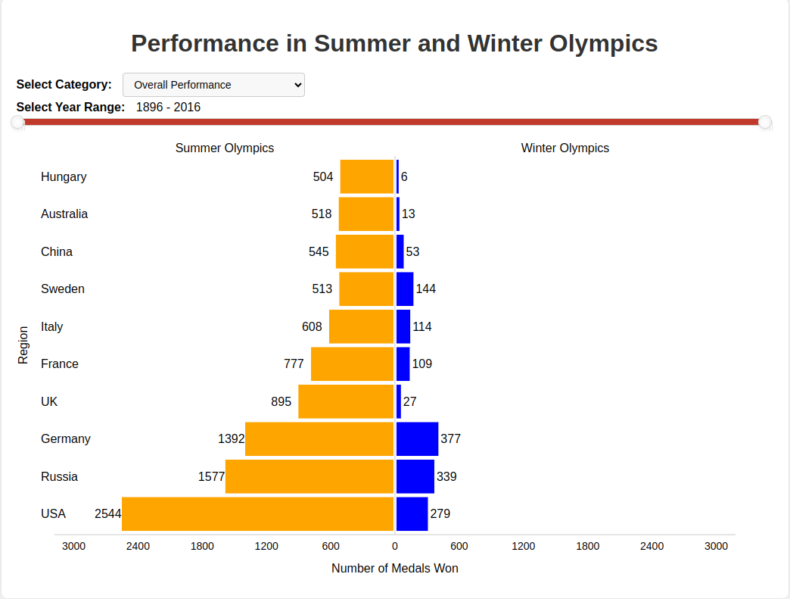
CS661
PERFORMANCE IN SUMMER AND WINTER OLYMPICS
APPROACH
Preprocessing the athlete data to segregate on the basis of Winter and Summer Olympics
Designing a Population Pyramid to showcase the number of medals win by top 10 region in Summer and Winter Olympics
Querying, Filtering and Selection support provided

Slide 12
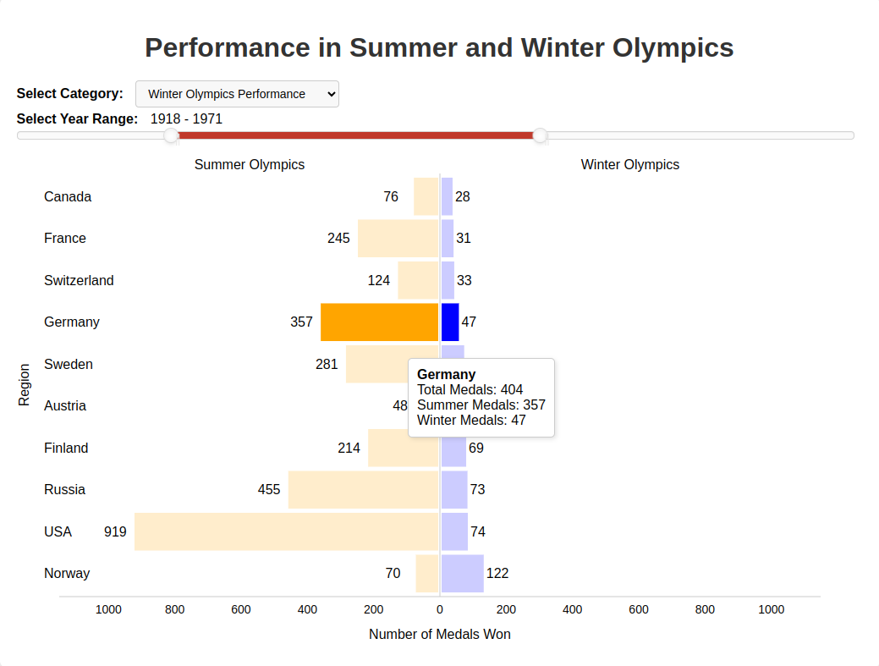
CS661
PERFORMANCE IN SUMMER AND WINTER OLYMPICS
POPULATION PYRAMID
Shows data corresponding to top 10 regions in selected category
Query on the basis of year range, which can be selected by the year-range slider
Select among 3 categories
Overall Performance
Summer Olympic Performance
Winter Olympic Performance
Popup appears on hovering over a bar showing the aggregated data of the respective region in detail

Slide 13
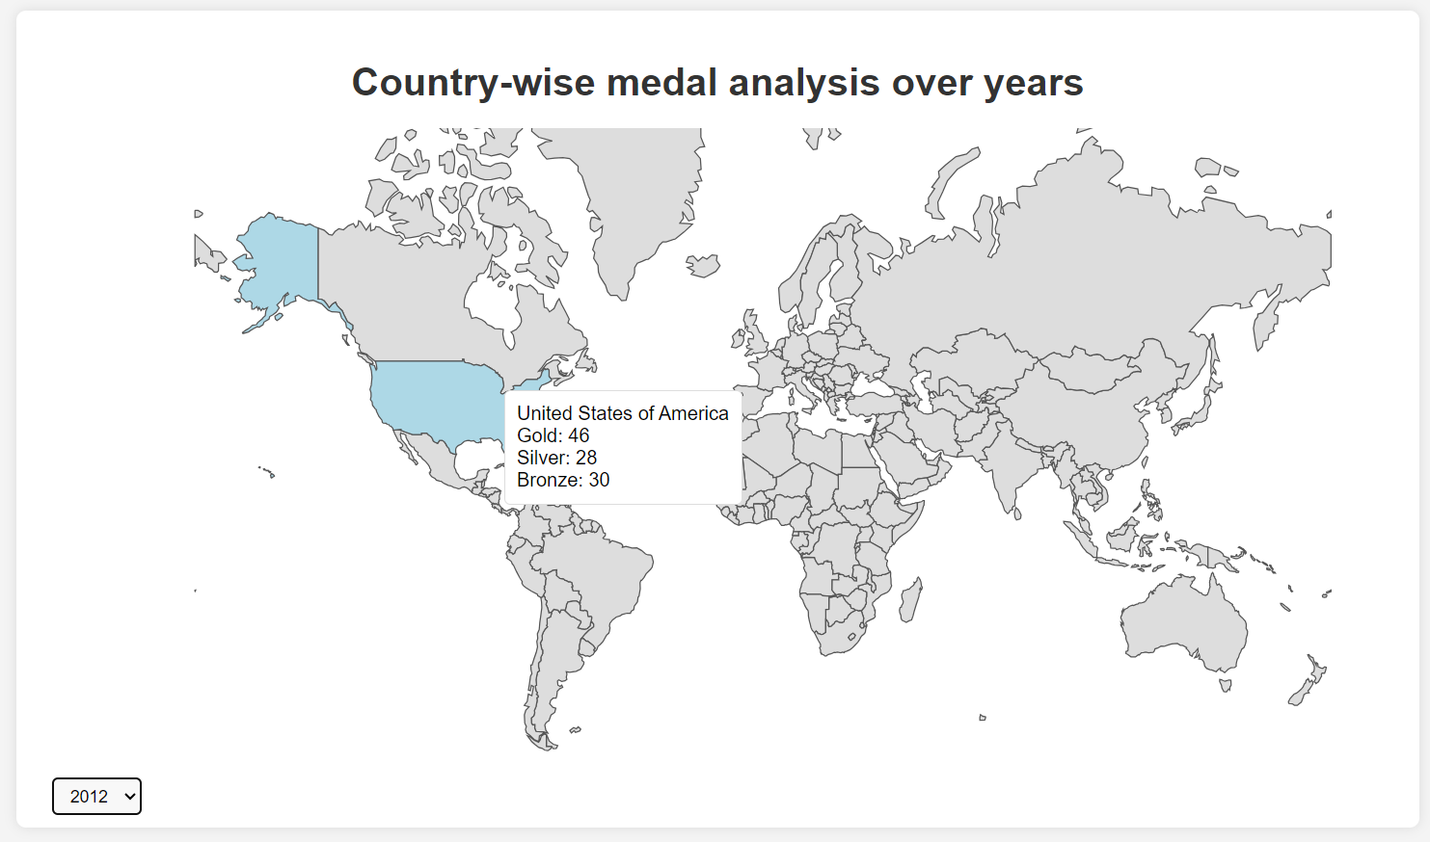
CS661
Country-wise medal analysis over years
Objective: This project aims to visually explore and analyze Olympic data to understand the distribution of medals won by countries over the years.
Dataset: We are using a comprehensive dataset containing information about medal counts (gold, silver, bronze) for each country across multiple Olympic Games.
Visualization Approach: Through interactive map, we'll illustrate how medal counts vary by country and year, allowing us to identify trends and patterns in Olympic performance.

Slide 14
CS661
EFFECT OF COUNTRY ECONOMICS ON MEDALS
APPROACH:
ECONOMIC PARAMETERS:
Dataset collection – Used Worldbank.org to collect data for economics and kaggle for olympic data
Data Processing – Used python script to clean and organise datasets
Framework used for visualisation – D3.js
Visual Variable used – Planar (for scatter plot)
Filters used - Economic parameters, Medal Type and year of olympics
Scalability – Given fixed number of countries, the only scalable parameter is number of years, for that we can use zoom and filter approach
GDP - Quantifies total value of goods and services produced annually
GINI - Measures income or wealth distribution within a population
GNI - Measures total income of a country's residents and businesses
Unemployment - %age of Labour force unemployed
Literacy - %age of population able to read and write

Slide 15
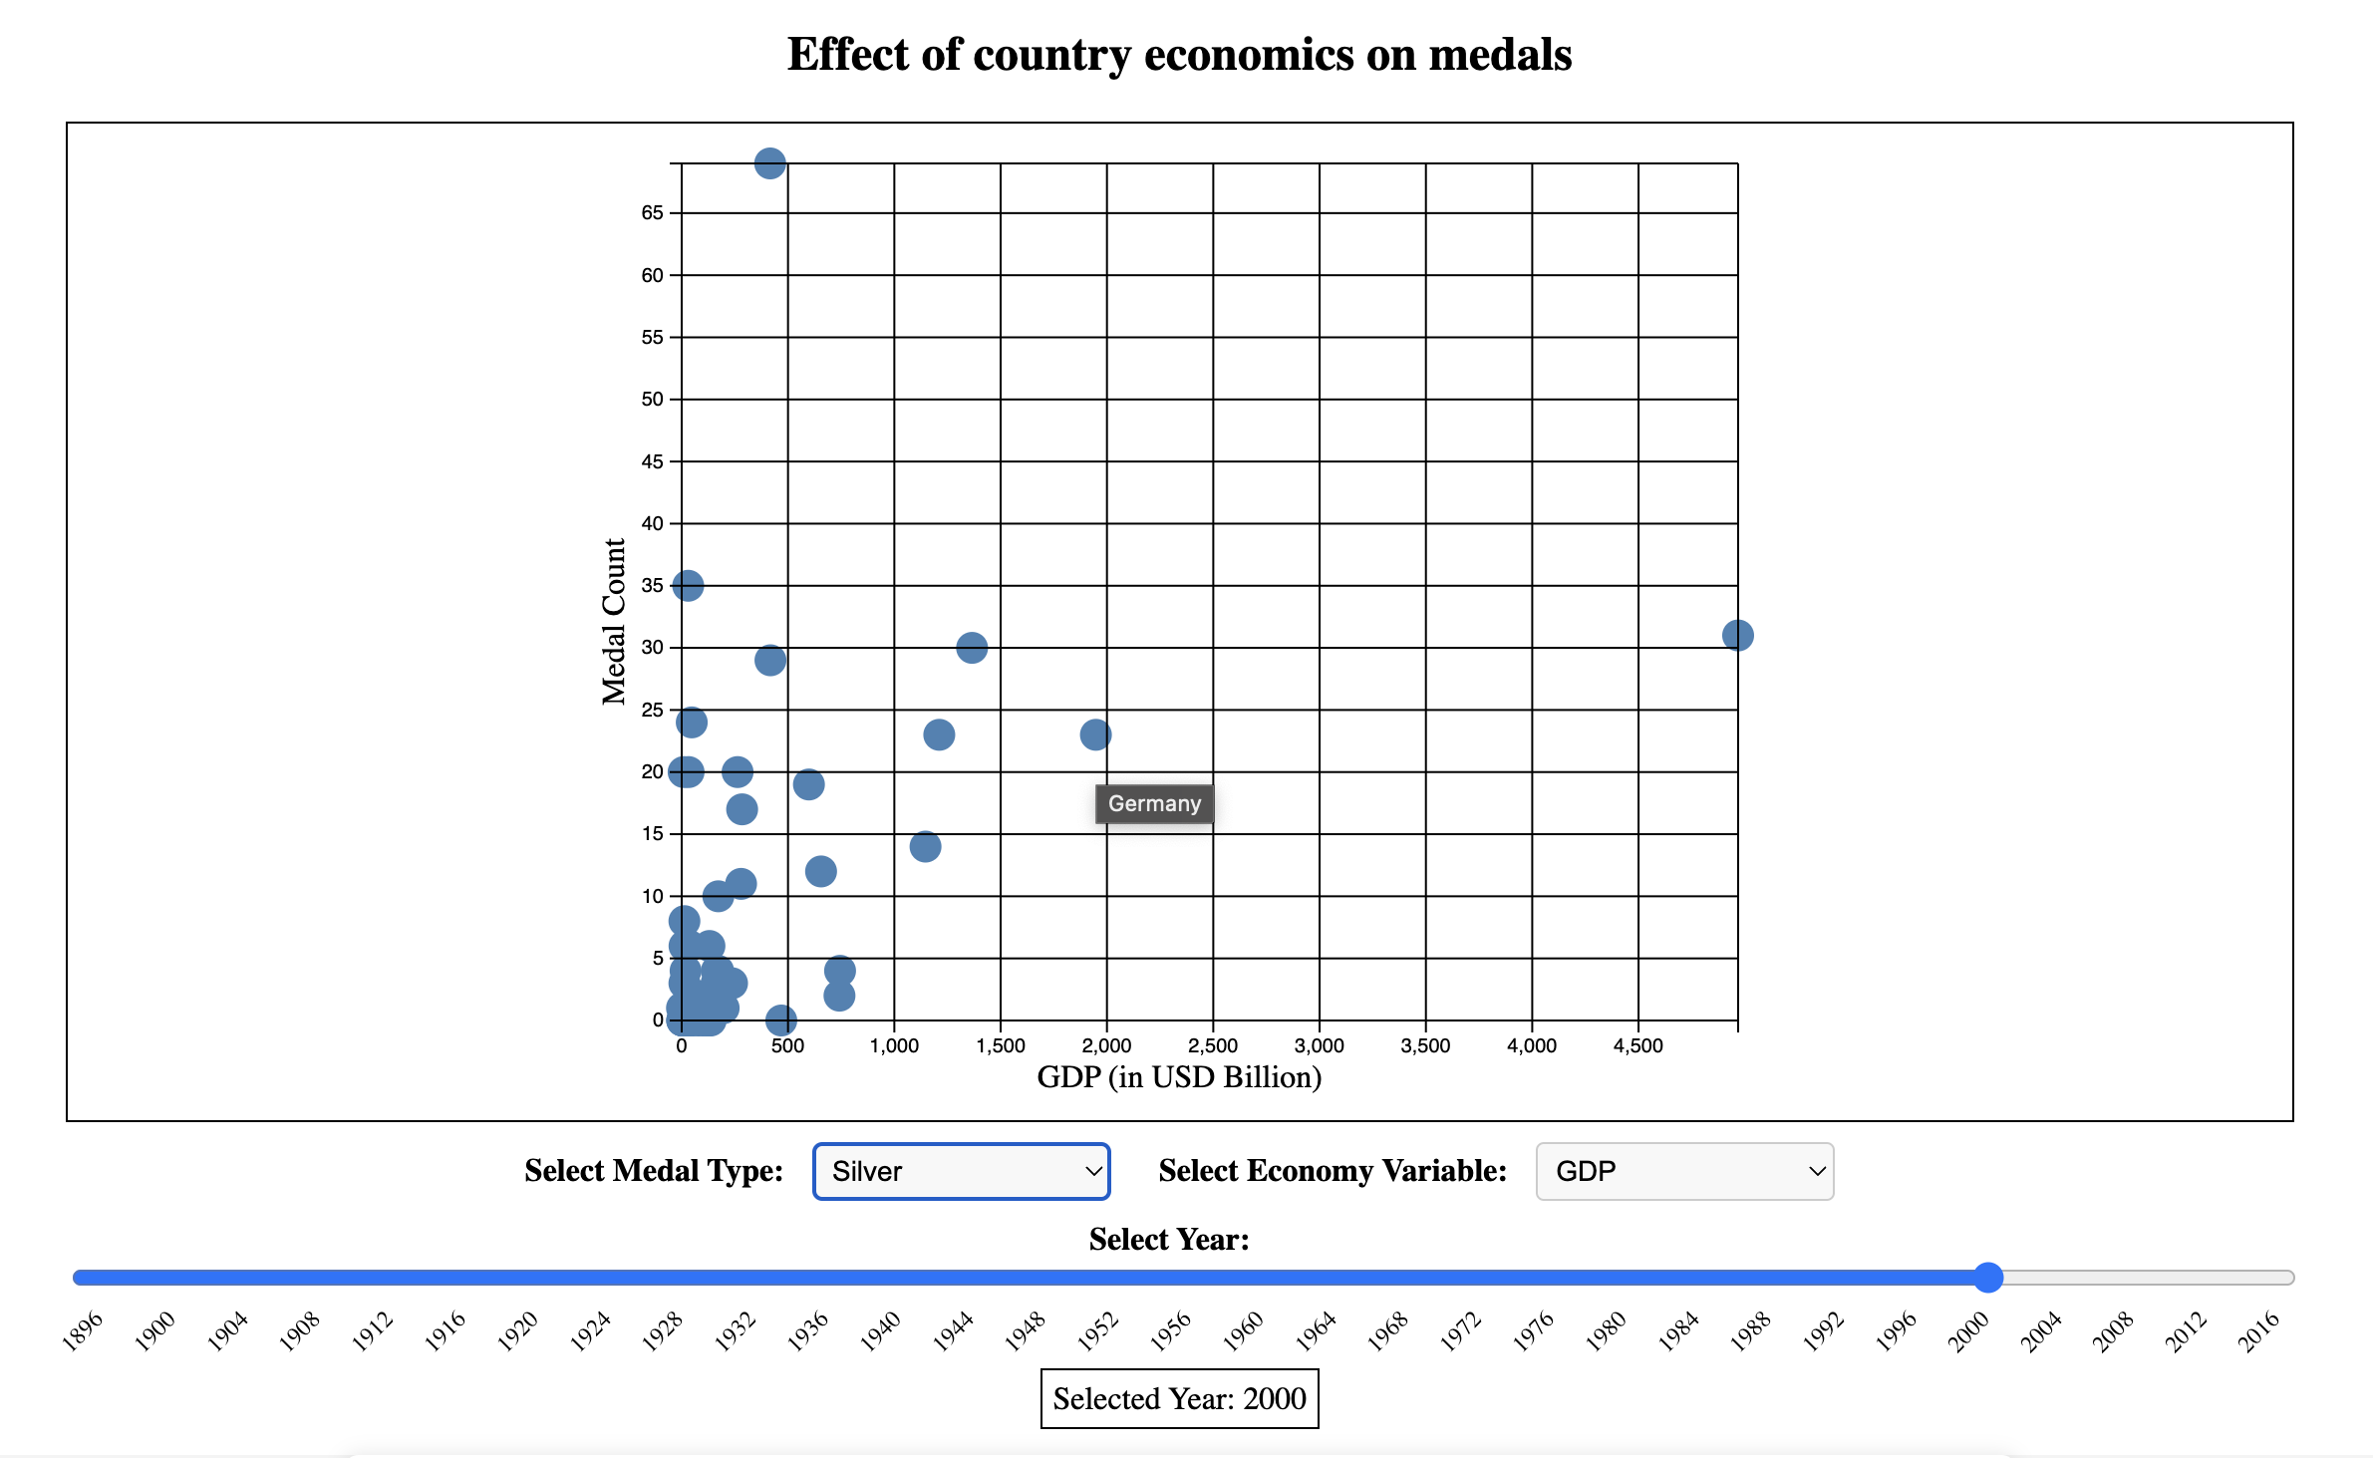
CS661
EFFECT OF COUNTRY ECONOMICS ON MEDALS
Canvas for scatter plot
Filter Dropdown
Slider to adjust year

Slide 16
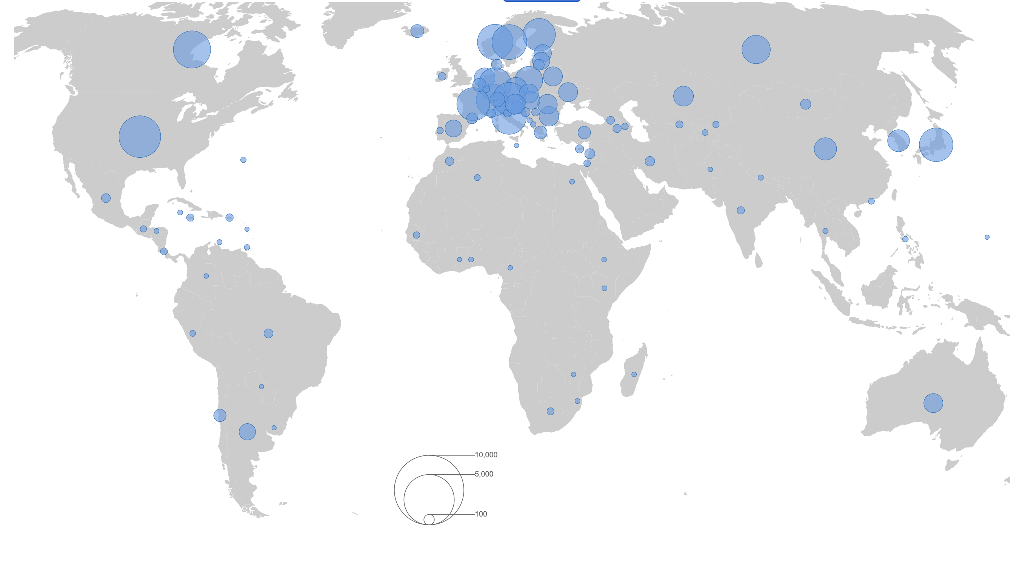
CS661
Totals Medals Won by Each countries
Objective: This project aims to visually explore and analyze Olympic data to understand the total of medals won by each countries.
Dataset: We are using a comprehensive dataset containing information about total medal counts for each country.
Visualization Approach: Through interactive bubble map, we'll illustrate how total medal counts vary by country, allowing us to identify trends and patterns in Olympic performance.

Slide 17

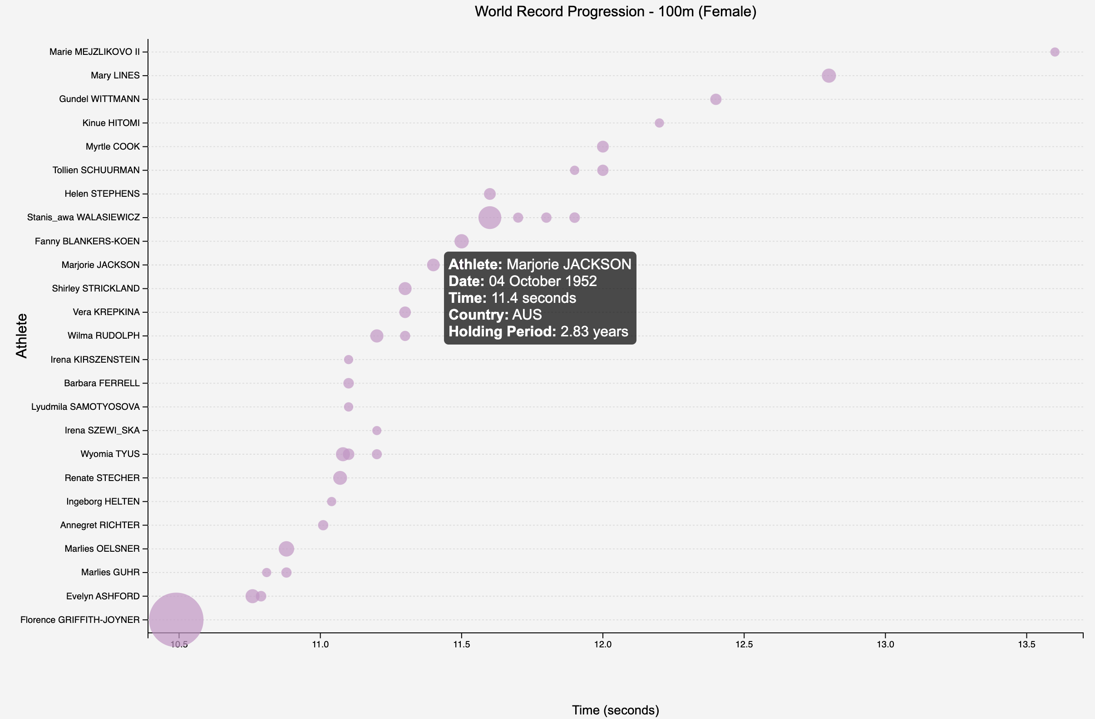
CS661
WORLD RECORD PROGRESSIONS
OBJECTIVE:
Depict trajectory of broken records for some sports along with time of holding a record by particular athlete
Best athlete of all time in a sport
Advancements in sport
Taken from 'worldathletics.org' separately for individual sport for both men and women
​​
DATASET:
Bubble chart: representing record with its size highlighting holding period
Tooltip: Dragging mouse over bubble show date on which record is made, name, country of athlete & holding period
Drop-down Menu: explore for different sports for both men and women
​
FEATURES:

Slide 18
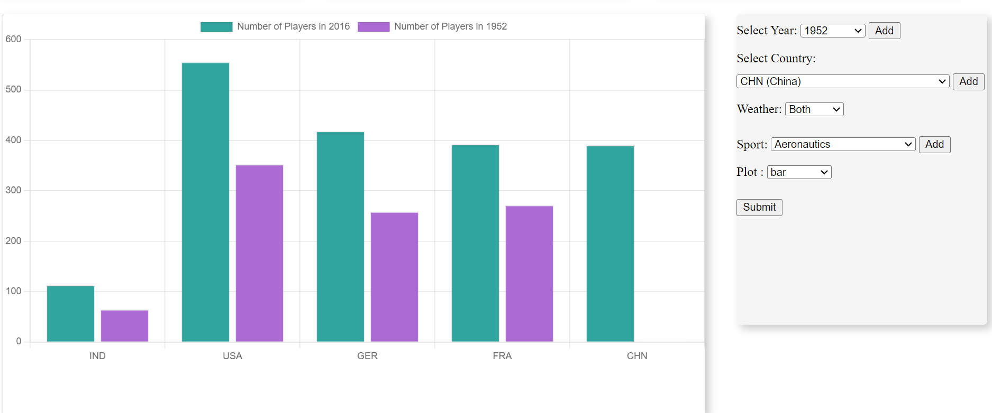
CS661
ATHLETES BY COUNTRY
OBJECTIVE
To provide an interactive platform for analyzing historical data of Olympic athletes across various sports, years, and countries.
To facilitate deeper insights into the participation and performance trends in the Olympics, allowing users to select specific parameters for detailed examination.
FEATURES
Year Selection
Country Selection
Sport Selection
Chart Type Selection
Form-based Inputs: Simple and intuitive forms for data input ensure that users without technical expertise can easily interact with the tool.
Chart Type Selection: Use of various chart types such as line, bar, pie, polar area, and radar. This allows for varied visual representation based on user preference or specific analysis needs.
Tools Used: HTML,CSS, JavaScript, ChartJs.

Slide 19
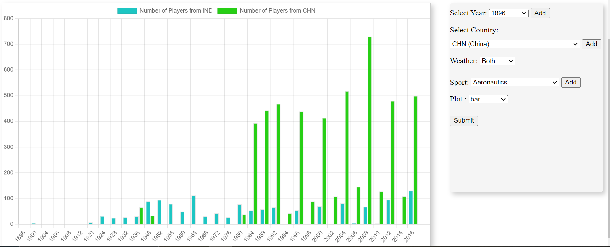
CS661
ATHLETES BY COUNTRY
OBJECTIVE
To provide an interactive platform for analyzing historical data of Olympic athletes across various sports, years, and countries.
To facilitate deeper insights into the participation and performance trends in the Olympics, allowing users to select specific parameters for detailed examination.
FEATURES
Year Selection
Country Selection
Sport Selection
Chart Type Selection
Form-based Inputs: Simple and intuitive forms for data input ensure that users without technical expertise can easily interact with the tool.
Tools Used: HTML,CSS, JavaScript, ChartJs.

Slide 20
THANK
YOU

